Slide 1
Liquidity Risk
Chapter 21

Slide 2
Types of Liquidity Risk
Liquidity trading risk
Liquidity funding risk

Slide 3
Liquidity Trading Risk
Price received for an asset depends on
  The mid market price
  How much is to be sold
  How quickly it is to be sold
  The economic environment
As we found during the GRC, transparency is also a factor that affects liquidity

Slide 4
Bid-Offer Spread As a Function of Quantity (Figure 21.1)
Offer Price
Bid Price
Quantity

Slide 5
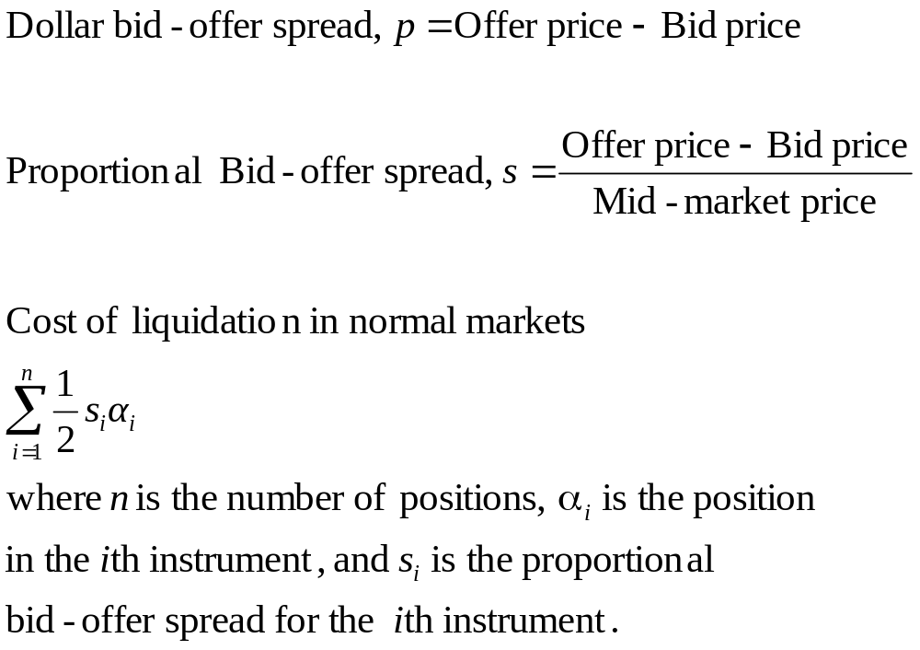
Bid-Offer Spread

Slide 6
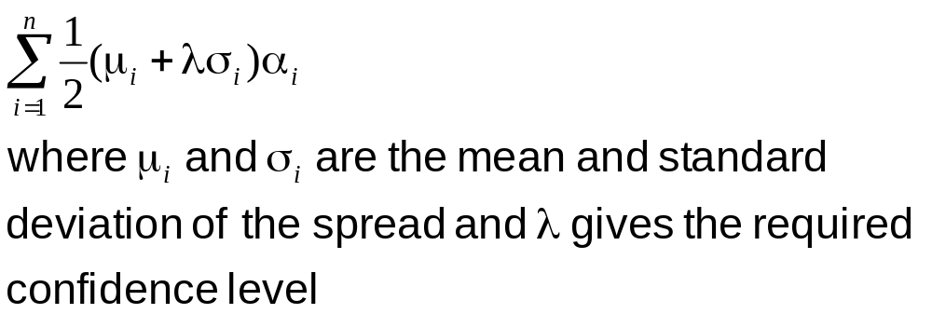
Cost of Liquidation in Stressed Markets

Slide 7
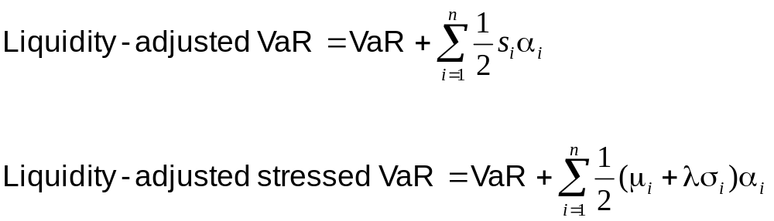
Liquidity-Adjusted VaR

Slide 8
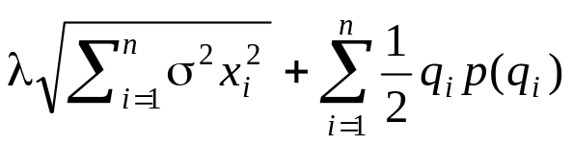
Unwinding a Position Optimally
Suppose dollar bid-offer spread as a function of units traded is p(q)
Suppose standard deviation of mid-market price changes per day is σ
Suppose that q_{i} is amount traded on day i and x_{i} is amount held on day i (x_{i} = x_{i-1}−q_{i})
Trader’s objective might be to choose the q_{i} to minimize

Slide 9
Example 21.3
A trader wishes to unwind a position in 100 million units over 5 days
p(q) = a+be^{cq} with a = 0.1, b = 0.05, and c = 0.03
σ = 0.1
With 95% confidence level the amounts that should be traded on successive days is 48.9, 30.0, 14.1, 5.1, and 1.9

Slide 10
Other Measures of Trading Liquidity
Volume of trading per day
Price impact of a trade
Absolute value of daily return divided by daily dollar volume (suggested by Amihud in 2002)
Research shows that an asset’s expected return increases as its liquidity decreases

Slide 11
Liquidity Funding Risk
Sources of liquidity
  Cash and Treasury securities
  Ability to liquidate trading positions
  Ability to borrow
  Retail and wholesale depoosits
  Securitization
  Central bank borrowing

Slide 12
Regulation
Liquidity coverage ratio: designed to make sure that the bank can survive a 30-day period of acute stress
Net stable funding ratio: a longer term measure designed to ensure that stability of funding sources is consistent with the permanence of the assets that have to be funded

Slide 13
Examples of Liquidity Funding Problems
Northern Rock (Business Snapshot 21.1)
Ashanti Goldfields (Business Snapshot 21.2)
Metallgesellschaft (Business Snapshot 21.3)

Slide 14
Liquidity Black Holes
A liquidity black hole occurs when most market participants want to take one side of the market and liquidity dries up
Examples:
  Crash of 1987 (Business Snapshot 21.4, page 557)
  British Insurance Companies (Business Snapshot 3.1)
  LTCM (Business Snapshot 16.1)

Slide 15
Positive and Negative Feedback Trading
A positive feedback trader buys after a price increase and sells after a price decrease
A negative feedback trader buys after a price decrease and sells after a price increase
Positive feedback trading can create or accentuate a black hole

Slide 16
Reasons for Positive Feedback Trading
Computer models incorporating stop-loss trading
Dynamic hedging a short option position
Creating a long option position synthetically
Margin calls

Slide 17
The Impact of Regulation
If all financial institution were regulated in the same way, they would tend to react in the same way to market movements
This has the potential to create a liquidity black hole

Slide 18
The Leveraging Cycle (Figure 21.2)
Investors allowed to increase to leverage
They buy more assets
Asset prices increase
Leverage of investors decreases

Slide 19
The Deleveraging Cycle (Figure 21.3)
Investors required to reduce leverage
They do this is by selling assets
Asset prices decline
Leverage of investors increases

Slide 20
Is Liquidity Improving?
Spreads are narrowing
But arguably the risks of liquidity black holes are now greater than they used to be
It is important to have diversity in financial markets where different groups of investors are acting independently of each other

